Slide 1
Analyzing FinTech Company Failures IN gERMANY data from Kaggle: https://www.kaggle.com/datasets/desalegngeb/german-fintech-companies
Sukwon Choi

Slide 2
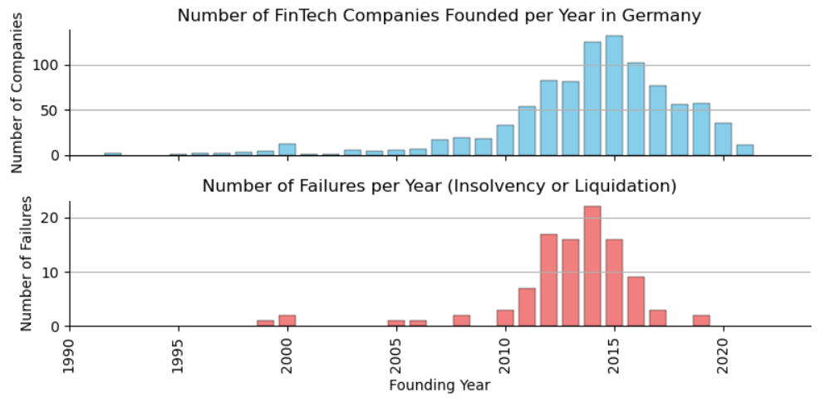
Trends in Establishment and Failure

Slide 3
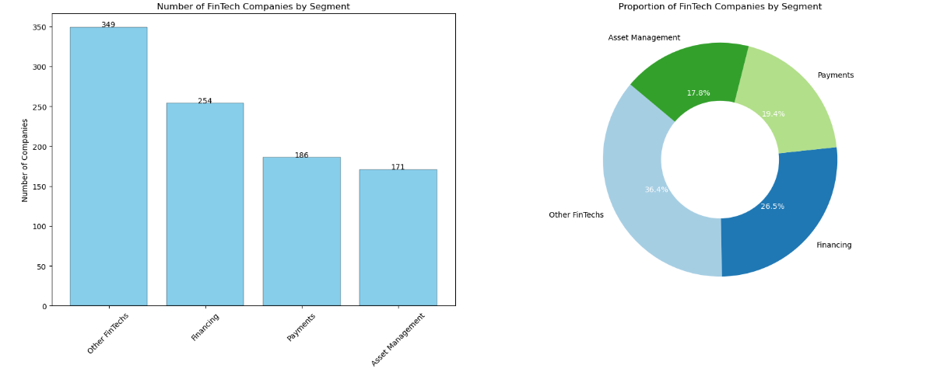
Segment distribution

Slide 4
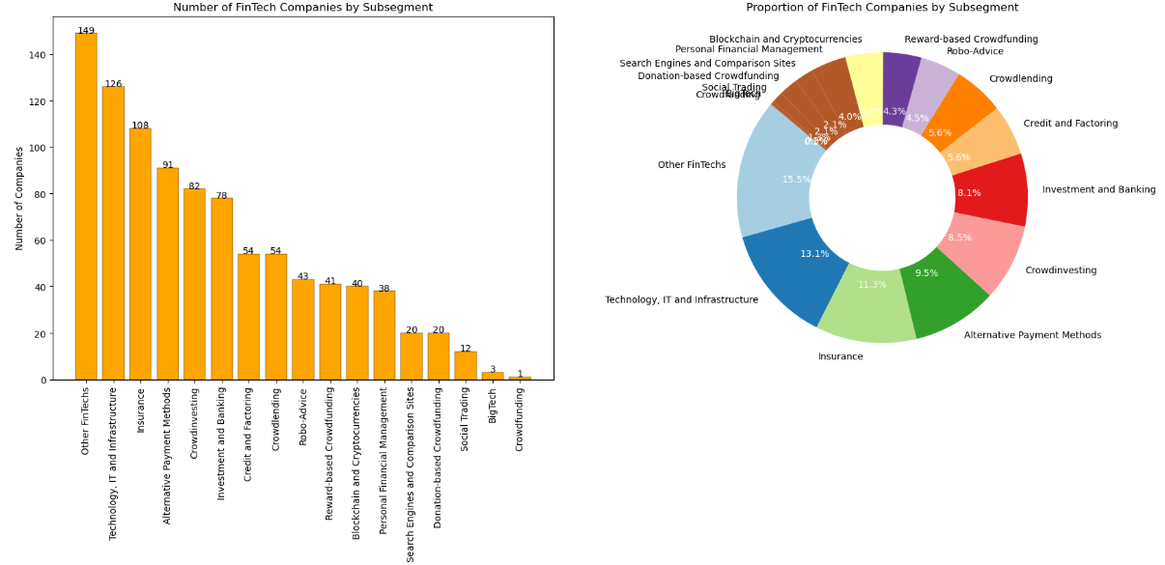
subSegment distribution

Slide 5
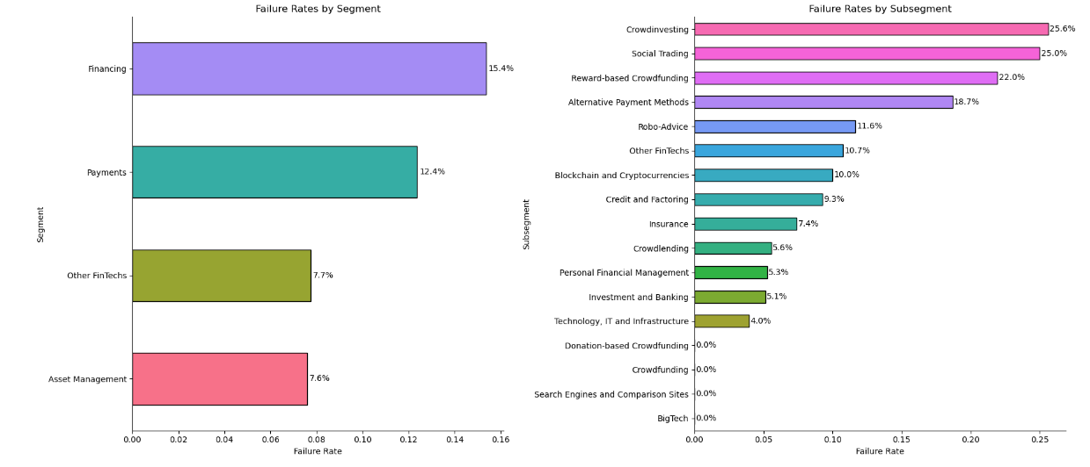
Failure Rates by segment and subsegment

Slide 6
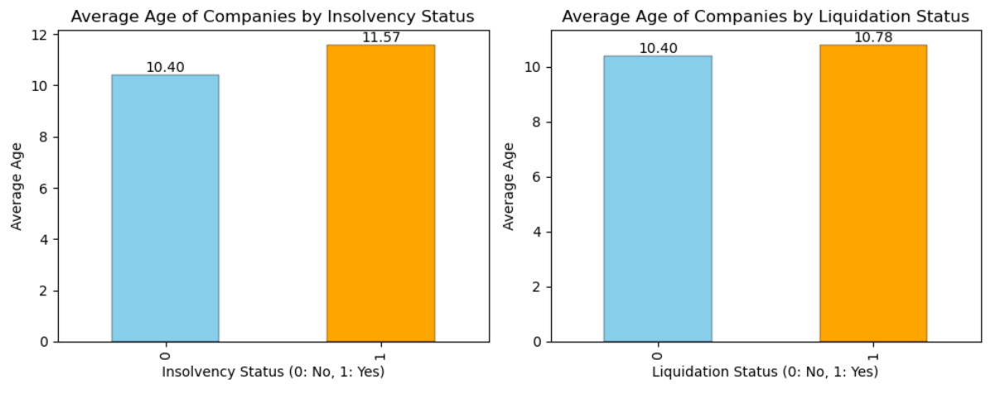
Company age and failure rate

Slide 7
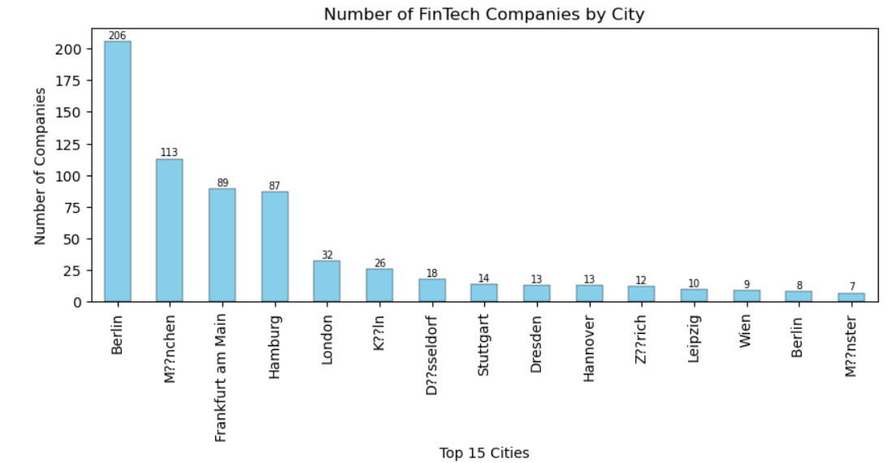
Geographical distribution of companies

Slide 8
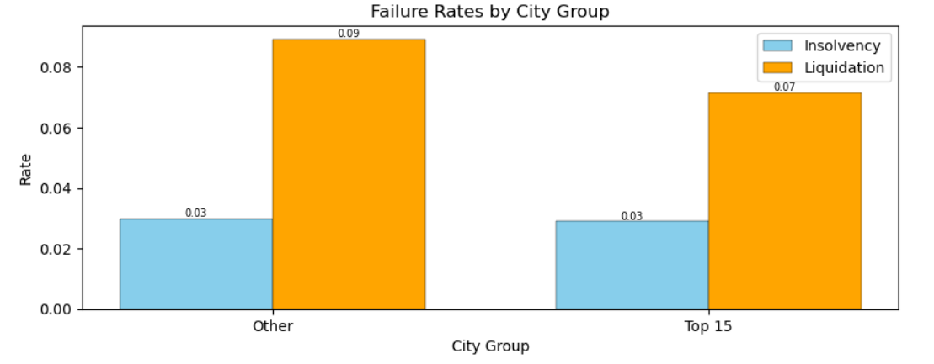
Location vs failure rate

Slide 9
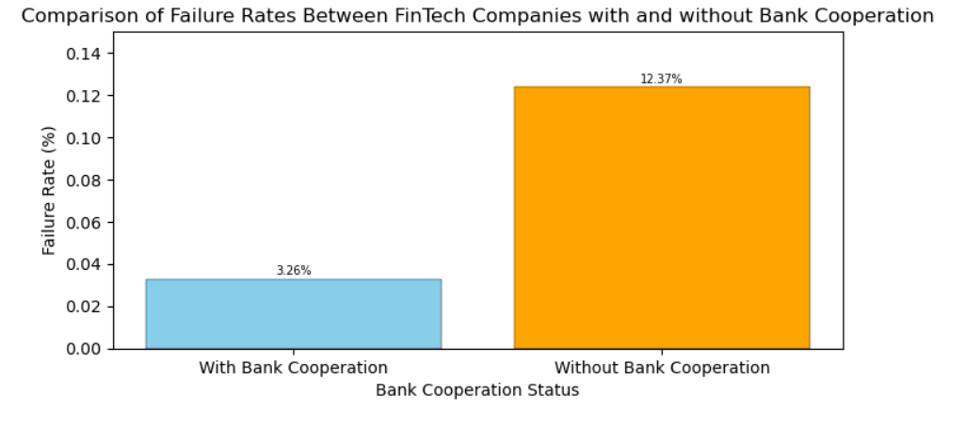
Cooperation with banks lower Failure Rate?

Slide 10
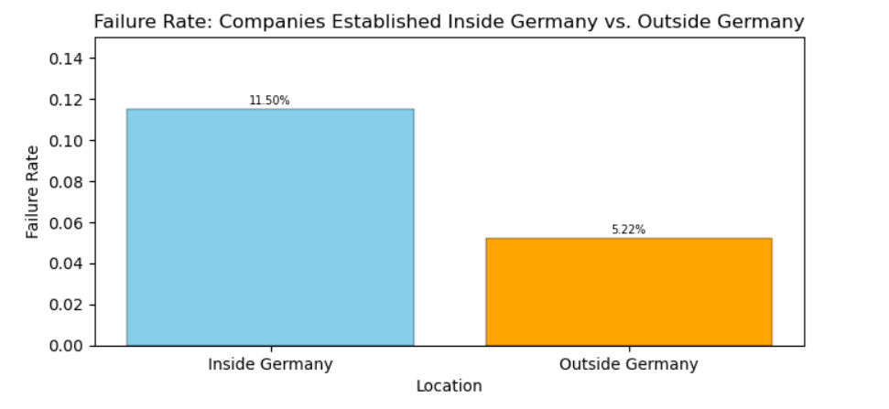
Country of Establishment and Failure Rate

Slide 11
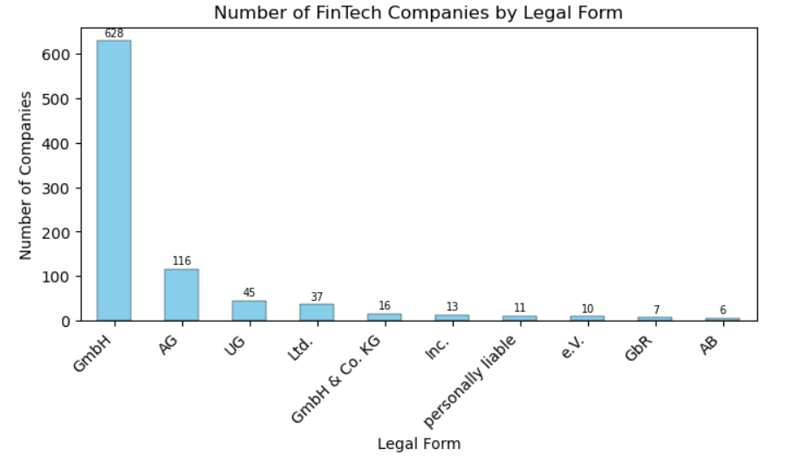
Legal form of company and Failure Rate (1)

Slide 12
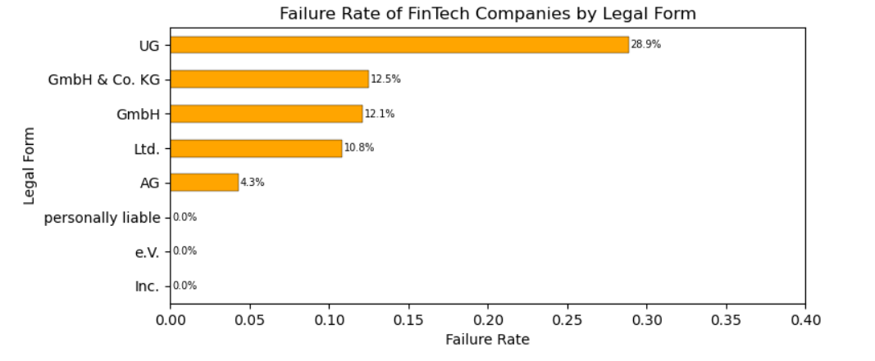
Legal form of company and Failure Rate (2)

Slide 13
Insights
ENTERING MATURITY STAGE
FAILURE BY SEGMENT
Stabilization in New Establishments and Failure:
A Stage Where Balanced Risk-Reward Opportunities Can Be Found
Significant Differences in Failure Rates Among Subsegments Within the Same Segment:
Consider Subsegment-Specific Risks When Exploring Investment Opportunities
STABLE RETURNS with LOW RISK
STABILITY OF FOREIGN COMPANIES
Opportunities Are Expected in FinTech Companies Collaborating with Traditional Banks
Pay Attention to FinTech Firms Entering Germany After Proving Their Competitiveness in Their Home Countries

